Slide 1
Adapter Design Pattern
Software Design Architecture Lab# 8 Saniya Sarim

Slide 2
Adapter Design Pattern
Adapter pattern works as a bridge between two incompatible interfaces. This type of design pattern comes under structural pattern as this pattern combines the capability of two independent interfaces.
This pattern involves a single class which is responsible to join functionalities of independent or incompatible interfaces.
Ex: A real life example could be a case of card reader which acts as an adapter between memory card and a laptop. You plugin the memory card into card reader and card reader into the laptop so that memory card can be read via laptop.

Slide 3
Why Adapter Design Pattern
For making compatibility.
Enhance and extend usage.
Loose coupling of classes.

Slide 4
When to Use this pattern?
When we want to make compatibility between incompatible system.
Adapter pattern acts as a bridge between two incompatible interfaces. This pattern involves a single class called adapter which is responsible for communication between two independent or incompatible interfaces.
Example: A card reader acts as an adapter between a memory card and a laptop. You plugins the memory card into card reader and card reader into the laptop so that memory card can be read via laptop.

Slide 5
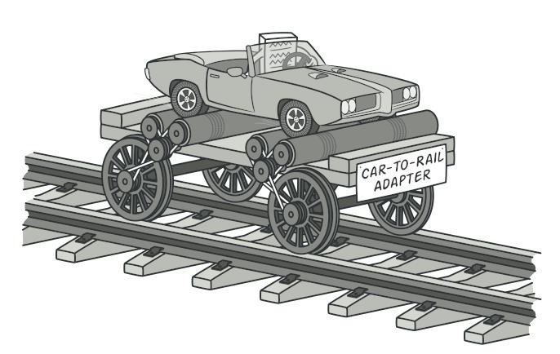
Example

Slide 6
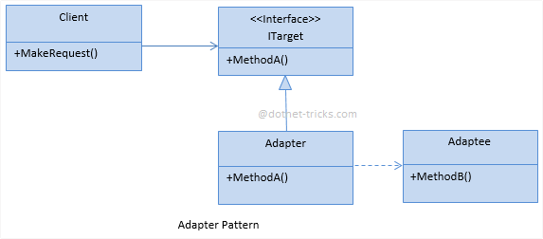
UML Diagram

Slide 7
Implementation Steps
Following are the steps for implementing Adapter design pattern.
Client Class
Adapter Class
Adaptee Class

Slide 8
Example Step by Step

Slide 9
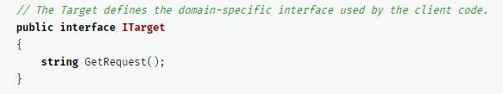
Step1

Slide 10
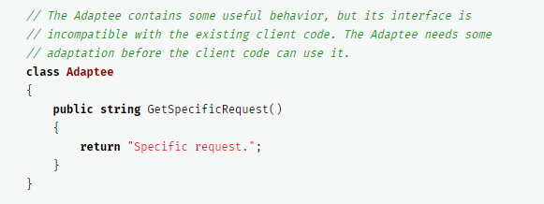
Step2

Slide 11
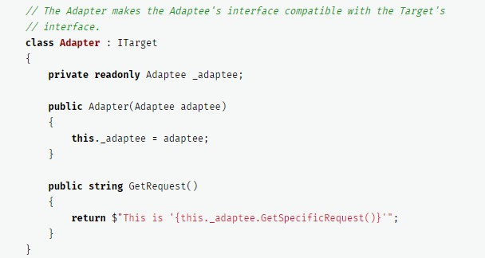
Step 3

Slide 12
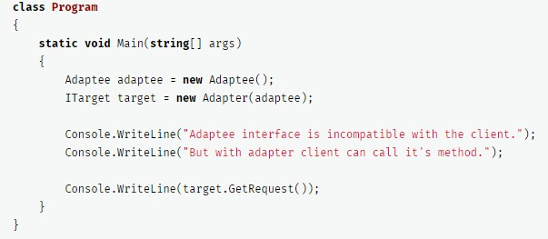
Consumation (Client Code)

Slide 13

Output

Slide 14
Tasks
1. You are working on a project where you get data from third party webapi/service in XML format. You are creating charts from that data for creating a chart you need data in JSON format in order to make them compatiable you need to convert xml data into json but limitation is you can’t modify third party webservice/api you have to make Adapter that returns data in JSON by using adapter pattern.

